Slide 1






DESeq
Sara Mahmoud
Allaa Ahmed
Yasmeen Elsayed
Fatema Atef
Rwnaa Samy

Slide 2



WHAT IS DESeq?
DESeq is a software package used in bioinformatics, particularly for the analysis of RNA-Seq data. It is designed to identify differential expression in count data, such as gene expression levels between different conditions or treatments.
WHAT IS THE JOB OF IT?
DESeq is used to determine which genes are differentially expressed across different experimental conditions. This is essential for understanding the molecular mechanisms underlying different biological states or responses.

Slide 3

1.Load the required library:
R
library(DESeq2)
The DESeq2 package is loaded, which is essential for differential expression analysis in RNA-seq data.

Slide 4
2. Read gene count data from CSV file:
R
gene_count_data <- read.csv("C:\\Users\\FreeComp\\Desktop\\data.csv", row.names = 1)
The gene count data is read from a CSV file into a dataframe. The row.names = 1 argument indicates that the first column contains the row names (gene names).

Slide 5
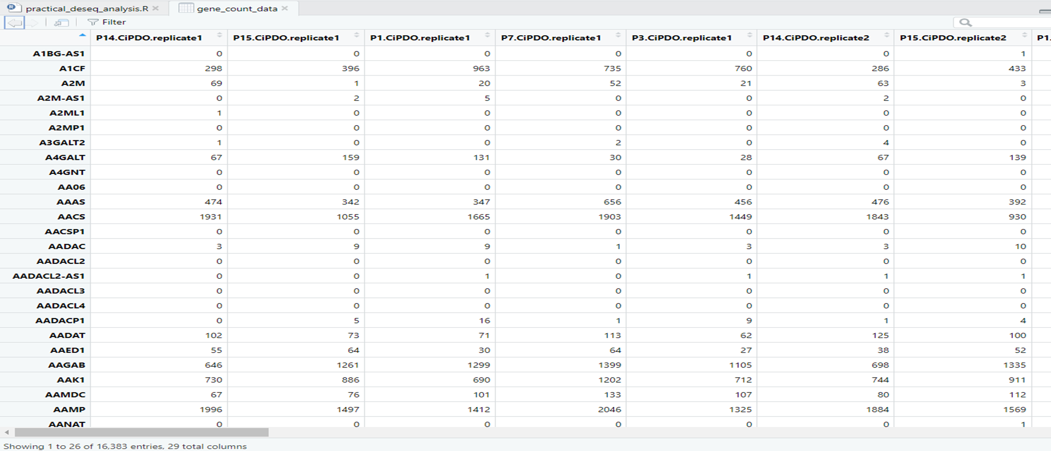

Slide 6
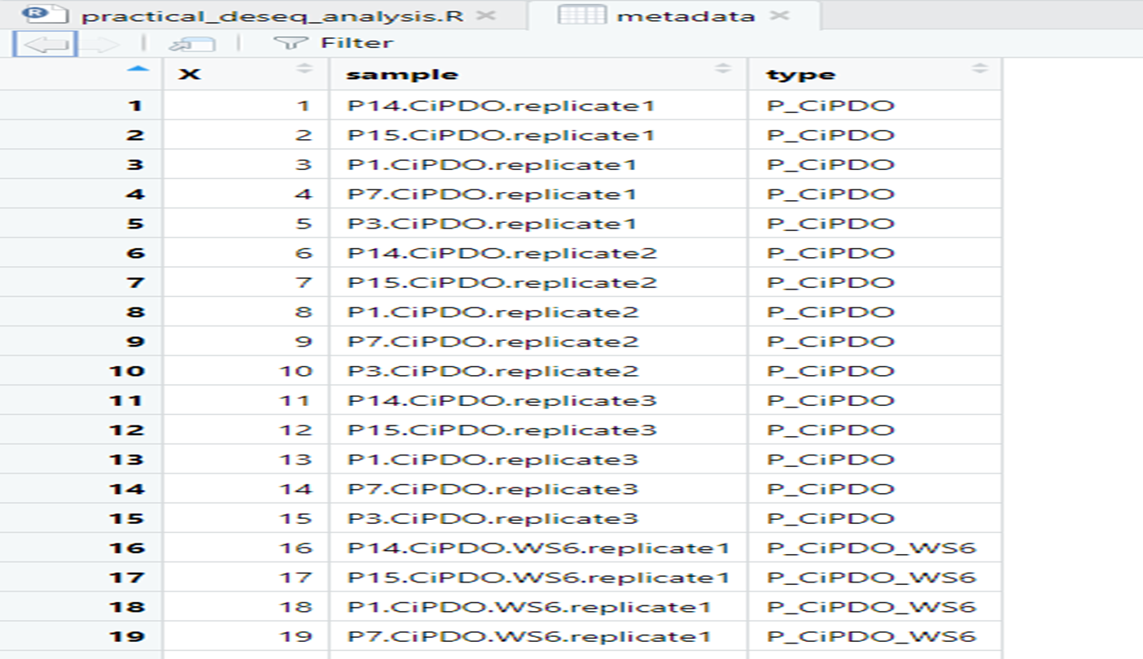
Read
3.Read metadata from CSV file:
R
metadata <- read.csv("C:\\Users\\FreeComp\\Desktop\\metadata.csv")
Metadata (sample information) is read from another CSV file into a dataframe.

Slide 7
4.Convert the 'type' column to a factor:
R
metadata$type <- as.factor(metadata$type)
The type column in the metadata is converted to a factor. This column is expected to contain the grouping information for the samples.
5.Create DESeqDataSet object:
R
dds <- DESeqDataSetFromMatrix(countData = gene_count_data, colData = metadata, design = ~ type)

Slide 8
A DESeqDataSet object is created using the count data and metadata. The design formula ~ type specifies that differential expression analysis will be performed based on the type factor.
6. Run DESeq analysis:
R
dds <- DESeq(dds)

Slide 9
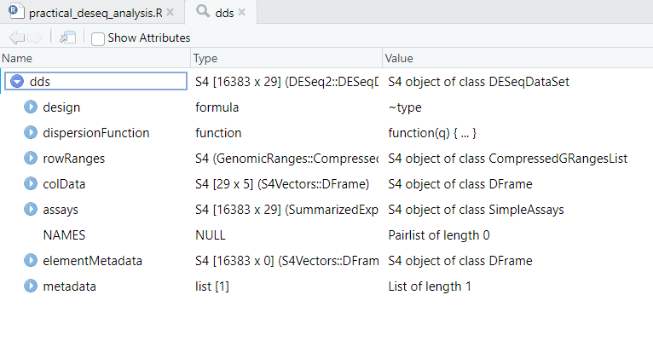
The DESeq function is used to perform the differential expression analysis

Slide 10
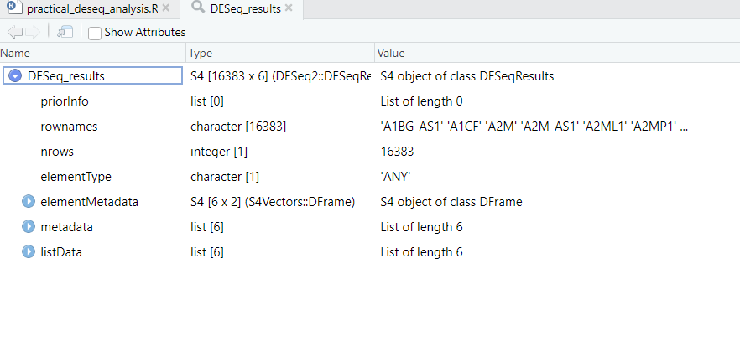
7.Perform differential expression analysis and obtain results:
R
DESeq_results <- results(dds)
The results function extracts the results of the differential expression analysis.

Slide 11
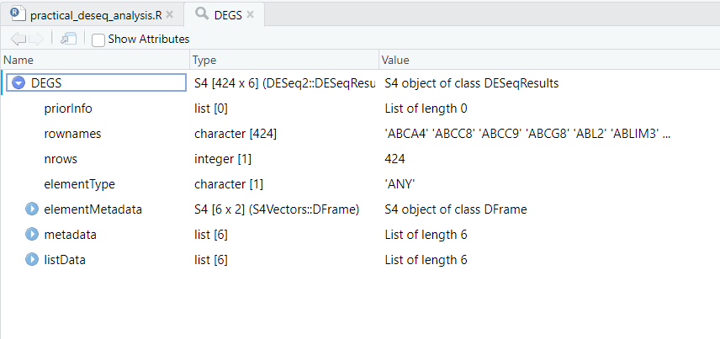
8.Subset DESeq results to get differentially expressed genes (DEGs):
R
DEGS <- subset(DESeq_results, abs(log2FoldChange) > 1 & padj < 0.1)
The results are filtered to obtain genes with an absolute log2 fold change greater than 1 and an adjusted p-value (padj) less than 0.1. These thresholds can be adjusted based on the stringency required.

Slide 12
9.DESeq results to a dataframe:
R
DEGS_df <- as.data.frame(DEGS)
The subsetted results are converted to a dataframe for easier manipulation and saving.

Slide 13
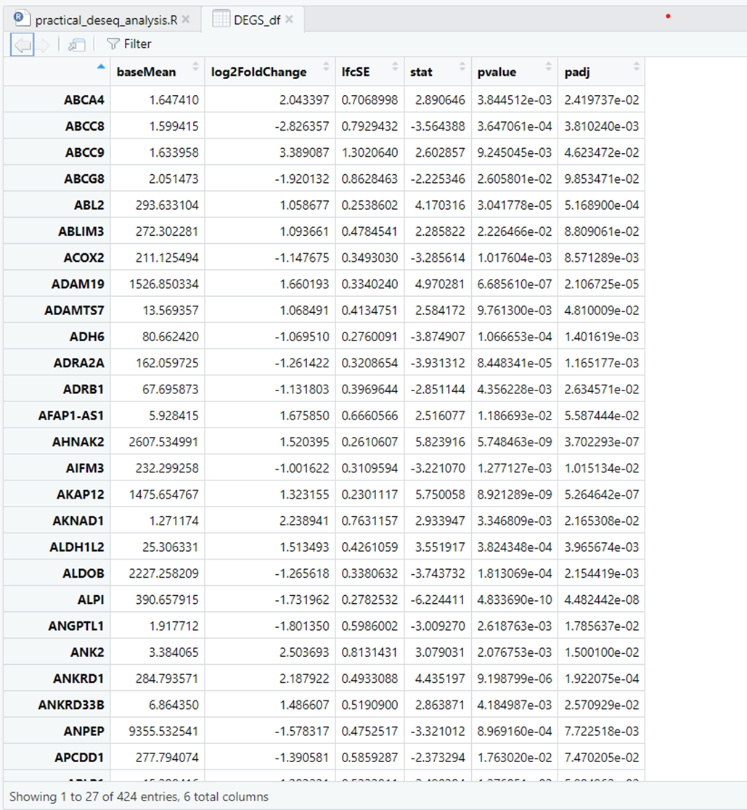

Slide 14
THANK YOU

